Slide 1

COVID-19 Had a Strange Impact on Air Quality
ECS-272
Yang Xue
Hamid Kamangir

Slide 2
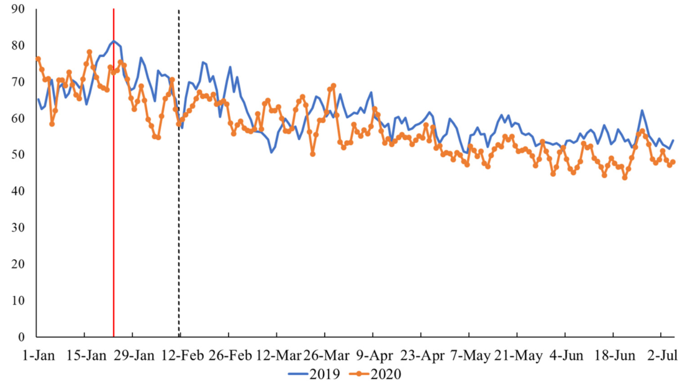
Literature Review
The results for global air quality change due to COVID-19 lockdown show that globally the air quality has been improved [1-3].
The air pollutant index in the graph start decreasing after the lockdown time (red line for Wuhan city in china and black dot line for global) and quantity for 2020 (orange line) is lower than 2019 (blue line)[1].

Slide 3
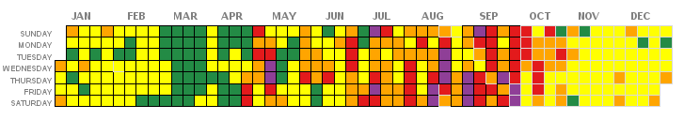
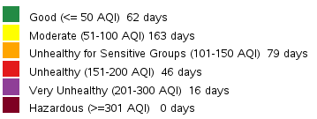
Literature Review
The 2020 December was a record setting one sewer wildfire for the state of California where 4.2 million acres burned, more than the last three years combined and one of the biggest fires in California’s history (since 1932) [4].

Slide 4
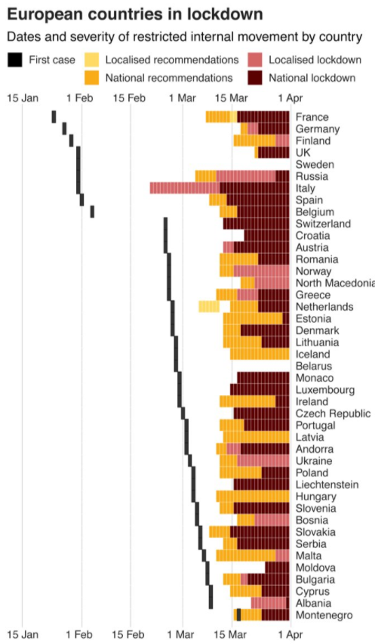
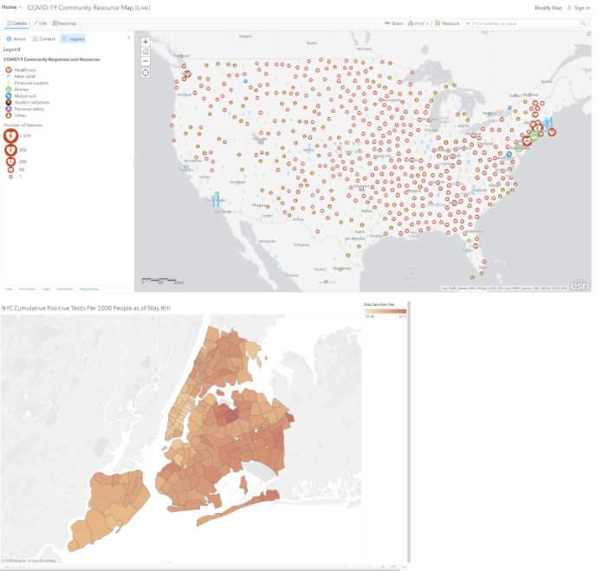
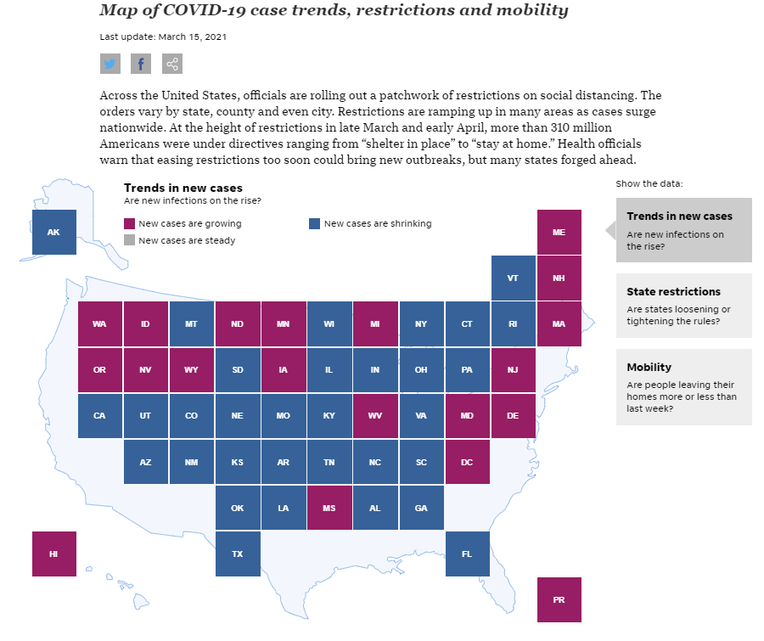
Literature Review

Slide 5
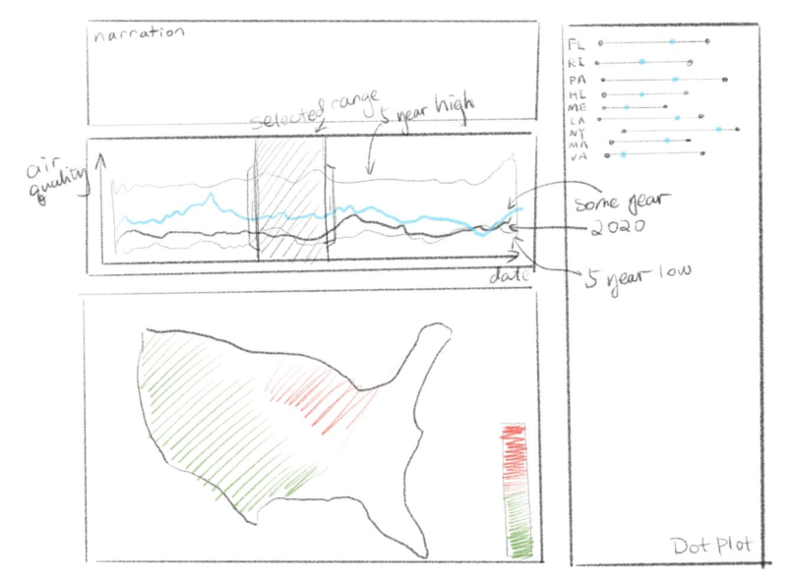
Narrative visualization Design and Implementation
Martini-glass
Narration
Line chart
Map
Dot plot

Slide 6
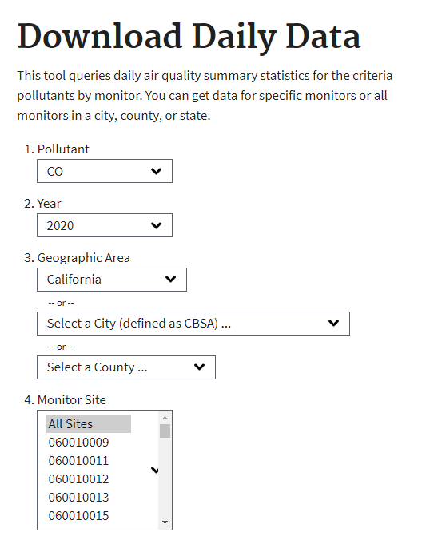
Outdoor air quality data
https://www.epa.gov/outdoor-air-quality-data/download-daily-data
Pollutant indexes:
CO; Pb; NO2; Ozone; PM10; PM2.5; SO2
Pre-processing:
Daily Air Quality for each state
Annual Min, Max, Mean, Air quality indexes for each state in USA

Slide 7

Demo

Slide 8
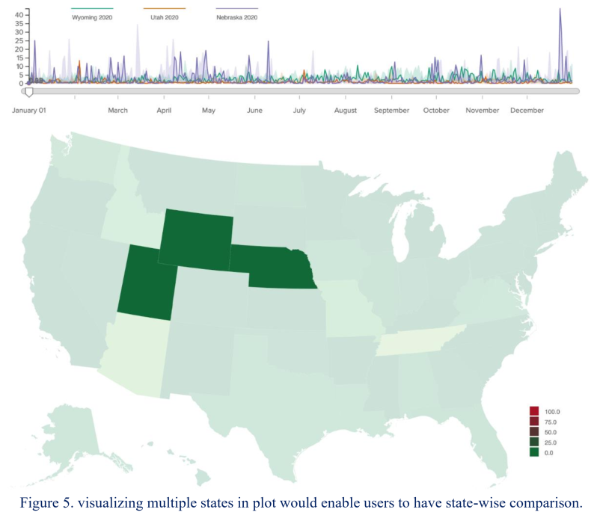
More options: visualizing multiple states

Slide 9
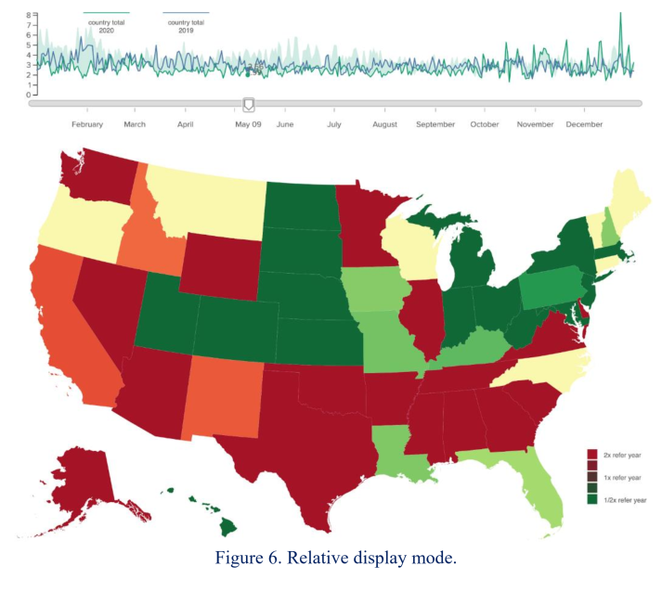
More options: Relative mode visualizing

Slide 10
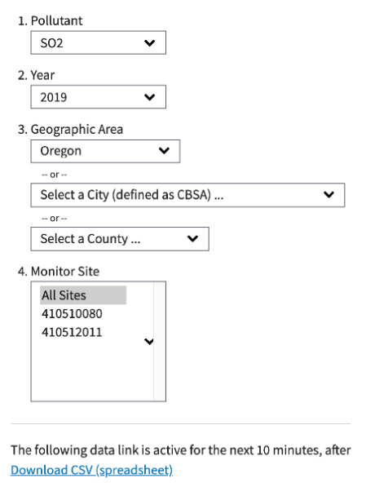
Future work
The original idea was to give users the ability to toggle between SO2, pm2.5, pm10, NO4, CO, etc.

Slide 11



Thank you

